Slide 1
“VUV photodissociation of O₂ , CO₂ , COS, and CH₃OH using velocity map imaging”
David H. Parker
Radboud University Nijmegen

Slide 2
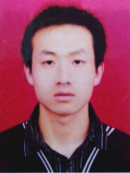
coworkers
DAN members
Dr. Gautam Sarma Chandan Bishwakarma
VUV Photodissociation RET in CO collisions
CW-TOP project “Imaging Astrochemistry”
“Radboud Excellence” program
Zhongfa Sun
Roy Scheidsbach
Prof. Arthur Suits (USA)
VUV photodissociation
RET in CO collisions
VMI of ice surfaces
with H. Cuppen, S. Ioppolo, J. Bouwman, H. Linnartz
Polarization dependent DCSs

Slide 3
goal
Measure branching ratios of all major channels in photodissociation of relevant molecules over the 100-200 nm region
Controlled conditions (clusters, rotation, vibration, electronic excitation, collisions, …)

Slide 4
cross sections
Notes:
OCS>O2>CH3OH>>CO2 Decreasing symmetry, increasing complexity
Understanding photodissociation due to work primarily at 157 nm – random place
Subtheme – state to state photodissociation studies at other wavelengths

Slide 5
diatomics
recoil:
E ⊥ μ k’
PE Curves: Σ, Π, Δ states
Parallel or perpendicular TDMs
Axial recoil?
Correlation diagrams as starting point for dissociation dynamics
E
Π
k’
D₁
D₀
Σ

Slide 6
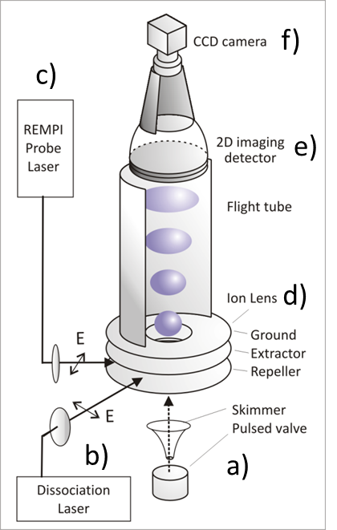
method Velocity Map Imaging
Angle-Speed distribution of state-selected products
Cold molecular beam
VUV photodissociation
Photoionization
Velocity Mapping Lens
Imaging detector
Camera
Needed:
Monomer with cold internal states
Photodissociation over full VUV
Probes for all channels
COS (¹A’) + hν → CO X¹Σ (v, J) + S(¹S)
CS A¹Π(v,J) + O(¹D)

Slide 7
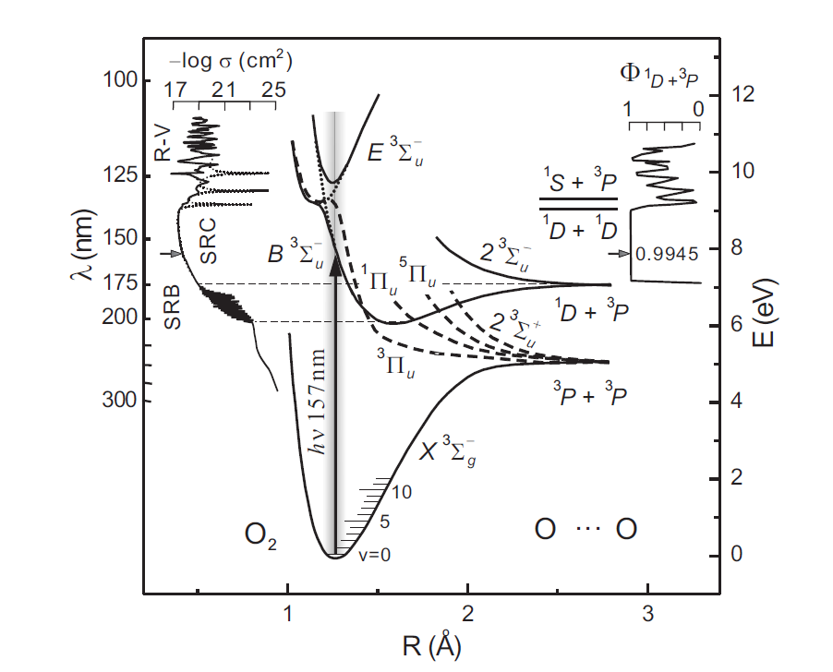
O₂ - understood
?
1³Π_{u} state
cross section
dissociation products
minor channel
test of theory
D₁
D₀

Slide 8
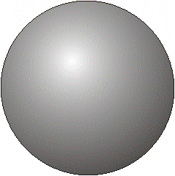
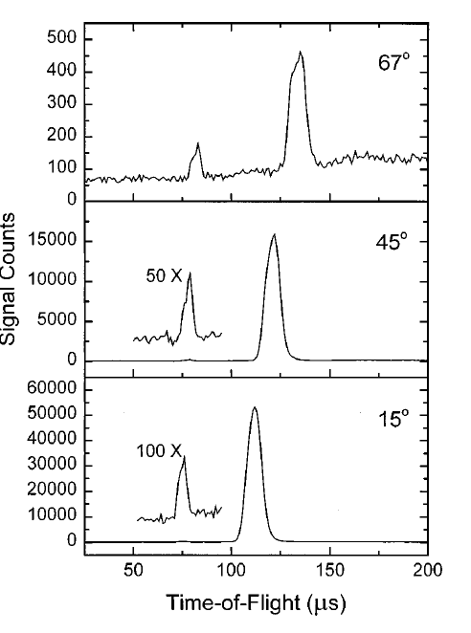
hν or e⁻
Previous Work
Universal Ionization Mass Spectrometer
O₂
J. Lin D. Hwang, YT Lee, XM Yang
JCP 109 1758 (1998)
hν
I (D₁)
II (D₀)
:
:

Slide 9
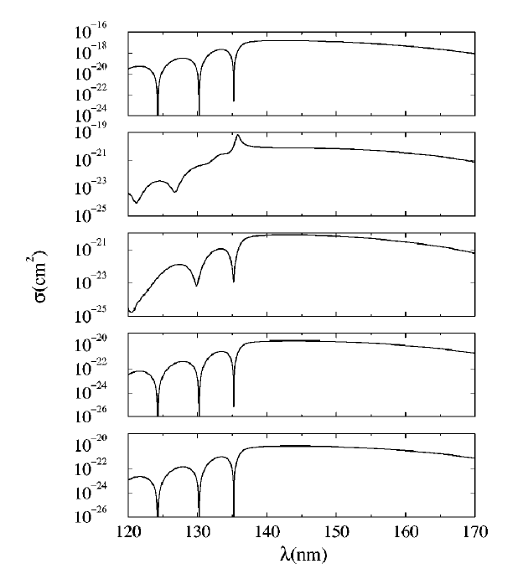
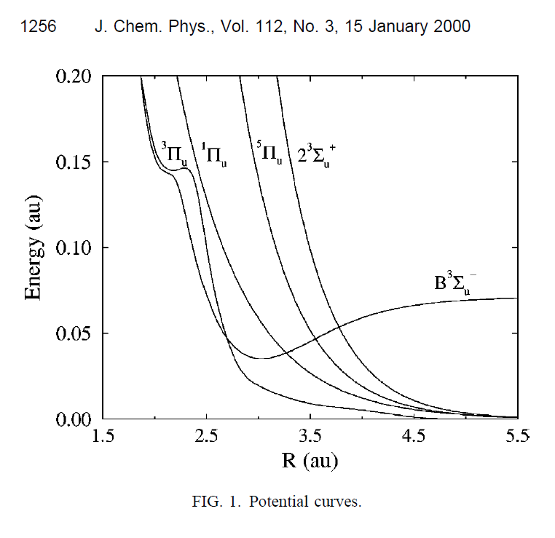
Theory
Balakrishnan, Jamieson, Dalgarno, Li, Buenker JCP 112, 1255 (2000)
B³Σ_{u}⁻
1³Π_{u}
¹Π_{u}
⁵Π_{u}
2³Σ_{u}⁺
1³Π_{u} ¹Π_{u} ⁵Π_{u} 2³Σ_{u}⁺
10⁻⁴
B³Σ_{u}⁻
10⁻³

Slide 10
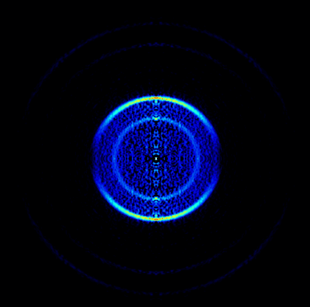
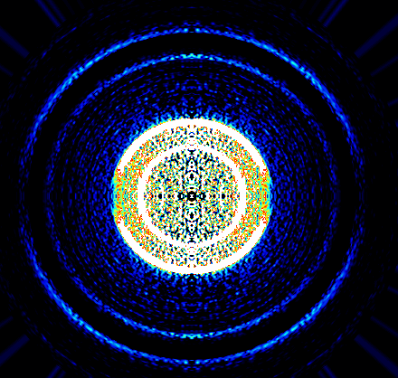
O₂ dissociation at 157 nm
O₂ @ 157 nm O(³P₁)
E_{laser}
D₀ 226 nm
D₁ 157 nm D₀
Ix20
Product atom | β D₁ | Branching D₁ (x 0.9945) | β D₀ | Branching D₀ (x 0.0055)
O(³P₂) | 2 ± 0.05 | 0.88 ± 0.02 | 0.75 ± 0.2 | 0.5 ± 0.1
O(³P₁) | 2 | 0.10 | 1.3 | 0.4
O(³P₀) | 2 | 0.02 | 0.4 | 0.1
Average ³P |  |  | 0.9 ± 0.3
O(¹D₂) | 2 (¹F det) | 1.0± 0.02 | 90% M_{J}=0

Slide 11
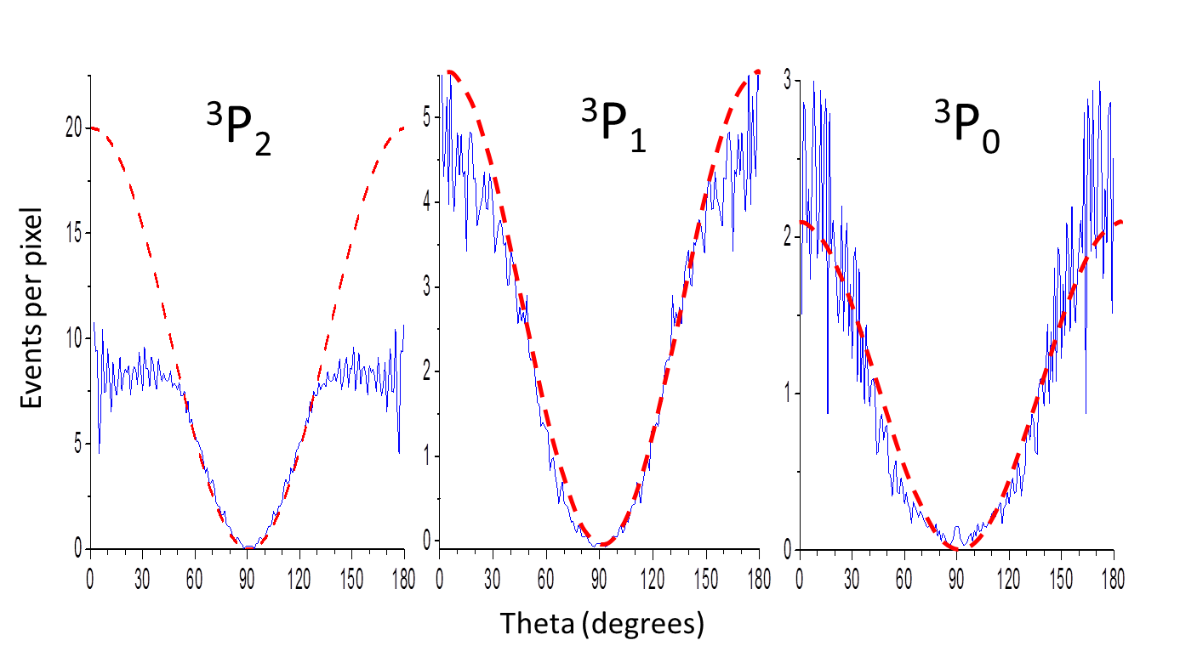
dynamic range
Sub-pixel Event Counting / Centroiding
undercounting

Slide 12
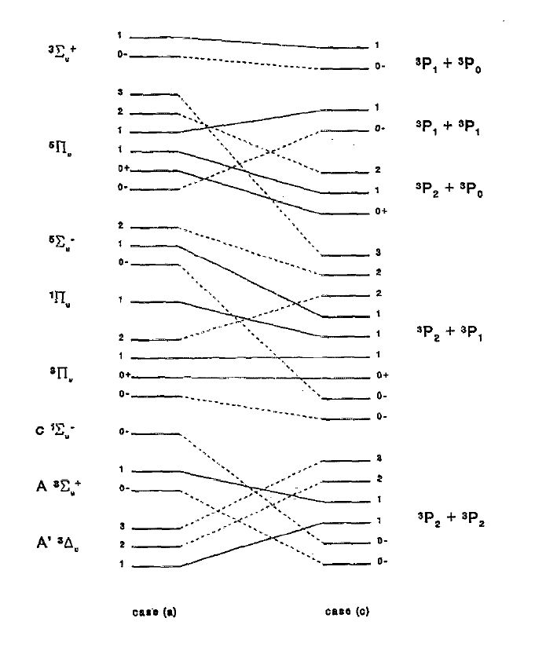
fine structure products
Ratio (B ³Σ_{u}⁻):(1 ³Π_{u}) = 2:1
Branching and betas are consistent with curve crossing from the B³Σ_{u}⁻ state to the ⁵Π_{u} and ¹Π_{u} states
However,
beta for O³P₀ is <2.
Mix between sudden and adiabatic limit
³Σ_{u}⁺
2/3
⁵Π_{u}
¹Π_{u}
1/3
³Π_{u}
Partial correlation diagram

Slide 13
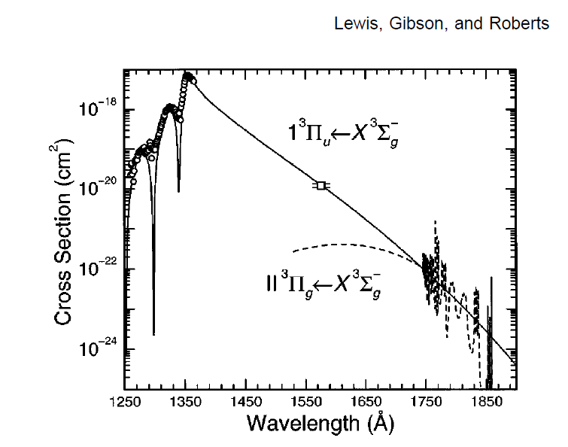
beyond 157 nm
146.3 nm
3x10⁻¹⁹cm²
2x10⁻³ of σ_{B-X}

Slide 14
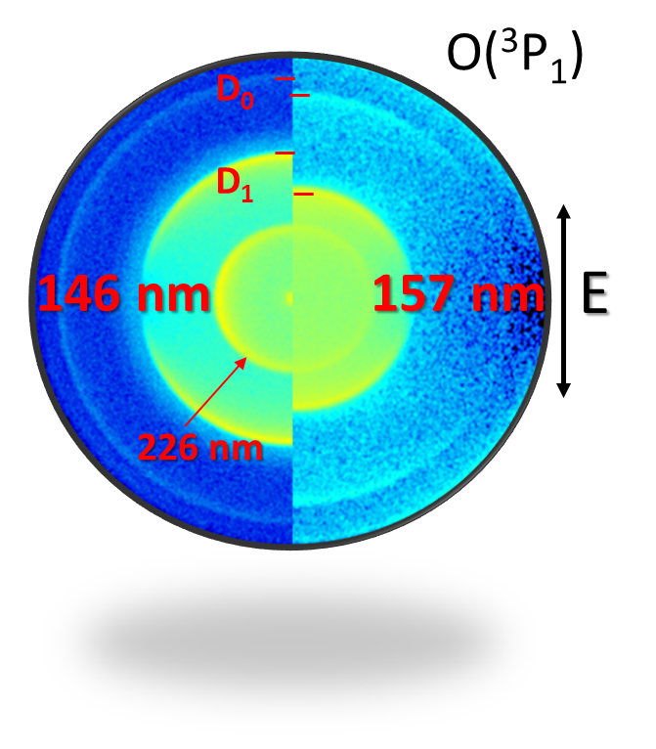
Log(Intensity)
157 D₀ – positive β
146 D₀ – negative β

Slide 15
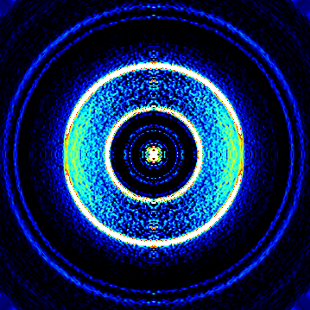
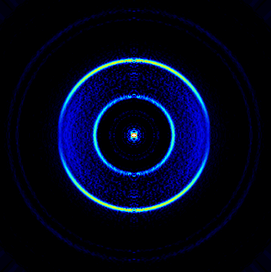
O₂ dissociation at 146 nm
O₂ @ 146 nm O(³P₂)
E_{laser}
D₀ 226 nm
D₁ 157 nm D₀
Ix20
Product atom | β D₁ | Branching D₁ (x 0.9945 (157 nm)) | β D₀ | Branching D₀ (x 0.0055)
O(³P₂) | 2 ± 0.05 | 0.88 ± 0.02 | -0.35 ± 0.1 | 0.88
O(³P₁) | 2 | 0.10 | -0.25 | 0.02
O(³P₀) | 2 | 0.02 | -0.35 | 0.06
Average ³P
O(¹D₂) | 2 ± 0.05 |  |  | M_{J}=0

Slide 16
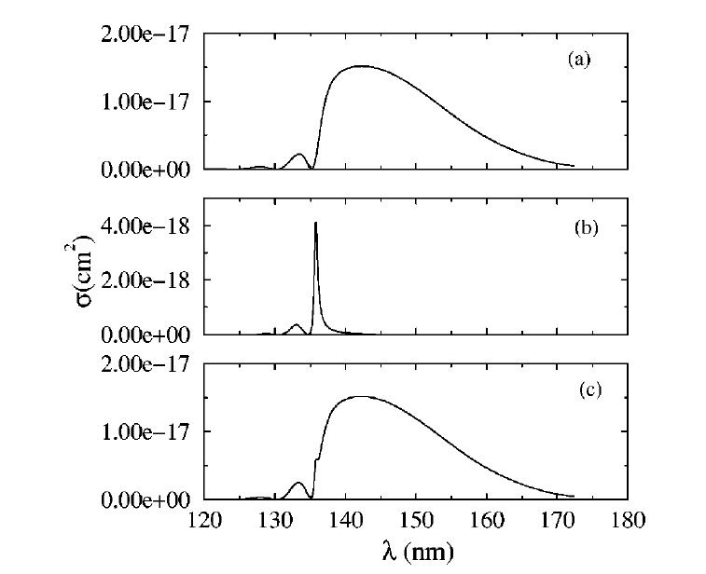
O₂: Large differences with theory - on a relative scale!
146 nm 157 nm
B³Σ_{u}⁻
B ~2x stronger
1³Π_{u}
from Lewis (x15)
x6
10⁻²⁰ cm^{2 157nm}
146 nm
total

Slide 17
from O₂ to CO₂ …
Secondary dissociation becomes possible
Interaction potential → 2 bond lengths + 1 angle
>100 rovibrational channels for CO
Nonlinear molecule: TDM mixed
Non-axial recoil affected by vibrational motion
Conical intersections, seams, etc.
Full quantum theory to long R not possible
Competition with photodissociation by ICR, IC, ISC.

Slide 18
PE surfaces
E. Heller, Ann Rev Phys Chem 1986
⊥ motion
parallel
Absorption Spectrum

Slide 19
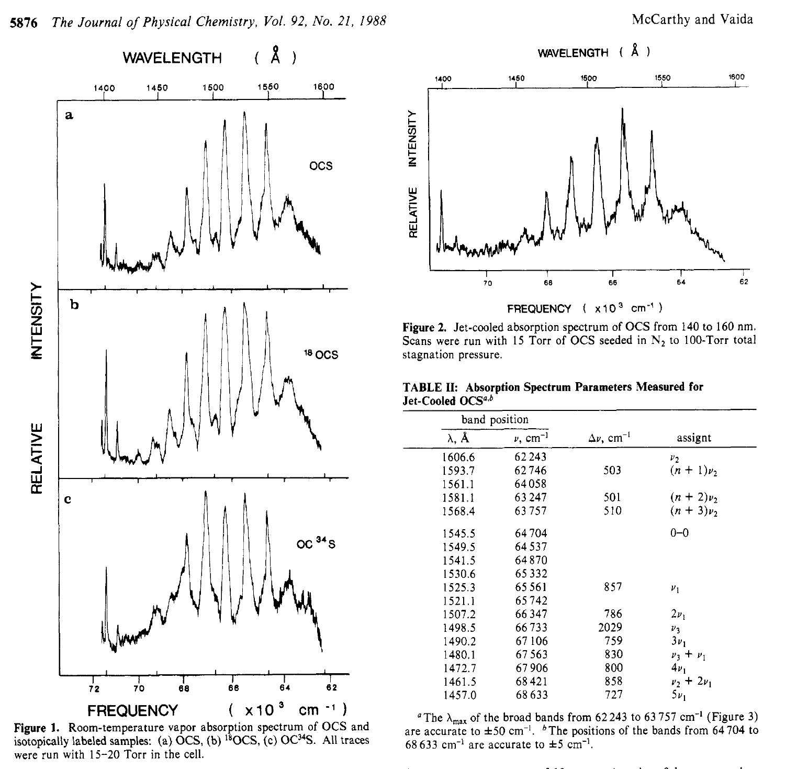
OCS absorption
Room
temperature
jet cooled
VUV absorption spectra of OCS by Vaida
static and jet-cooled
Position of origin band?

Slide 20
OCS photodissociation
COS (X¹A’) + hν → CO X¹Σ (v, J) + S(¹S)
CS A¹Π(v,J) + O(¹D)
Major Channel
Previous Work: Yamanouchi
CO X¹Σ (v, J) + 170-150 nm → CO A¹Π → LIF
S(¹S) + 219 nm →S(³D°) → LIF

Slide 21
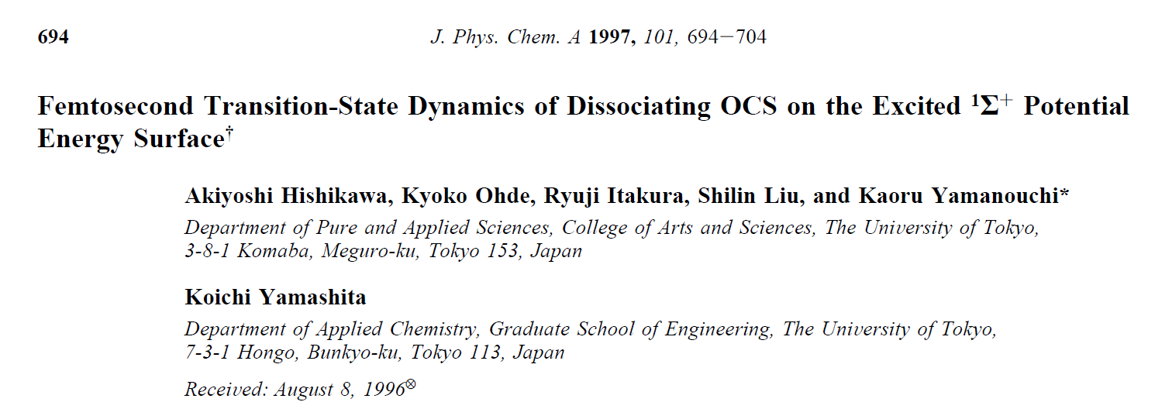
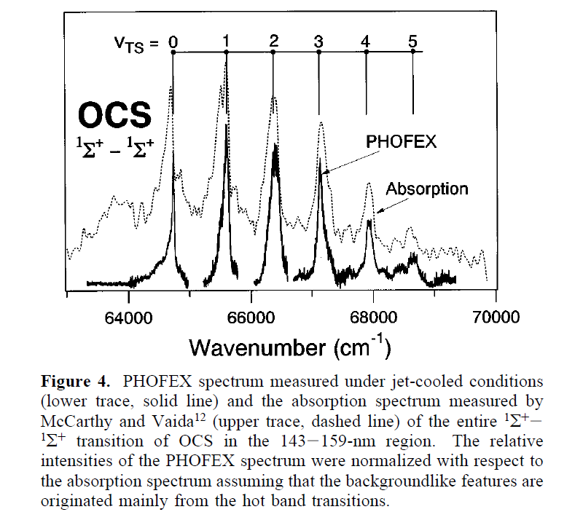
6
4
2
0
σ x 10⁻¹⁹ cm²
PHOFEX
158 156 154 152 nm
Peak at 157 nm disappears in Phofex spectrum!

Slide 22
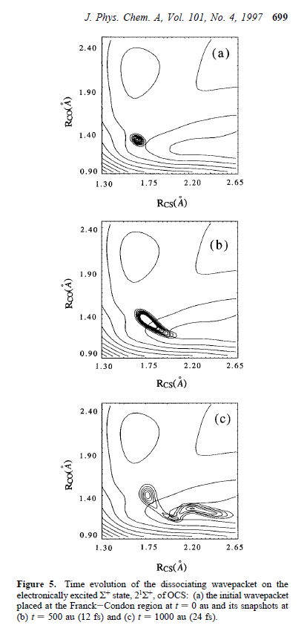

Slide 23
Detection of S(¹S) atoms
S(³D°)
219 nm
CO +S(¹D)
156-150 nm
20 ns
LIF
S(³P)
COS

Slide 24
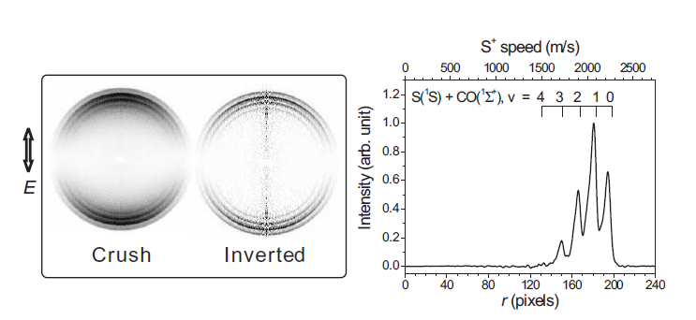
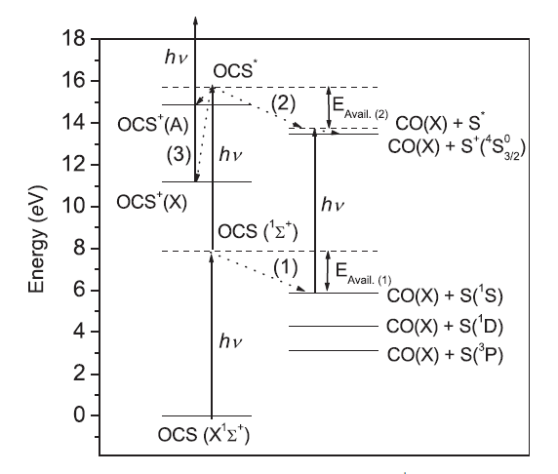
157nm accidentally resonant with autoionizing resonance of S(¹S)

Slide 25
6
4
2
0
σ x 10⁻¹⁹ cm²
PHOFEX
F₂ laser
158 156 154 152 nm
σ(cm²)
S(¹S) autoionization cross section
McGuire PRA 19 1978 (1979)

Slide 26
detection of S(¹S) atoms
S⁺
Autoionization
S(³D°)
~157 nm
same laser pulse
219 nm
S(¹D)
CO +S(¹D)
156-150 nm
20 ns
LIF
S(³P)
COS

Slide 27
OCS photodissociation
COS (X¹A’) + hν → CO X¹Σ (v, J) + S(¹S)
CS A¹Π(v,J) + O(¹D)
Major Channel
Previous Work: Yamanouchi
CO X¹Σ (v, J) + 170-150 nm → CO A¹Π → LIF
S(¹S) + 219 nm →S(³D°) → LIF
Our Work: CO VUV imaging
CO X¹Σ (v, J) _{158-152 nm} → CO A¹Π _{158-152 nm} → CO⁺

Slide 28
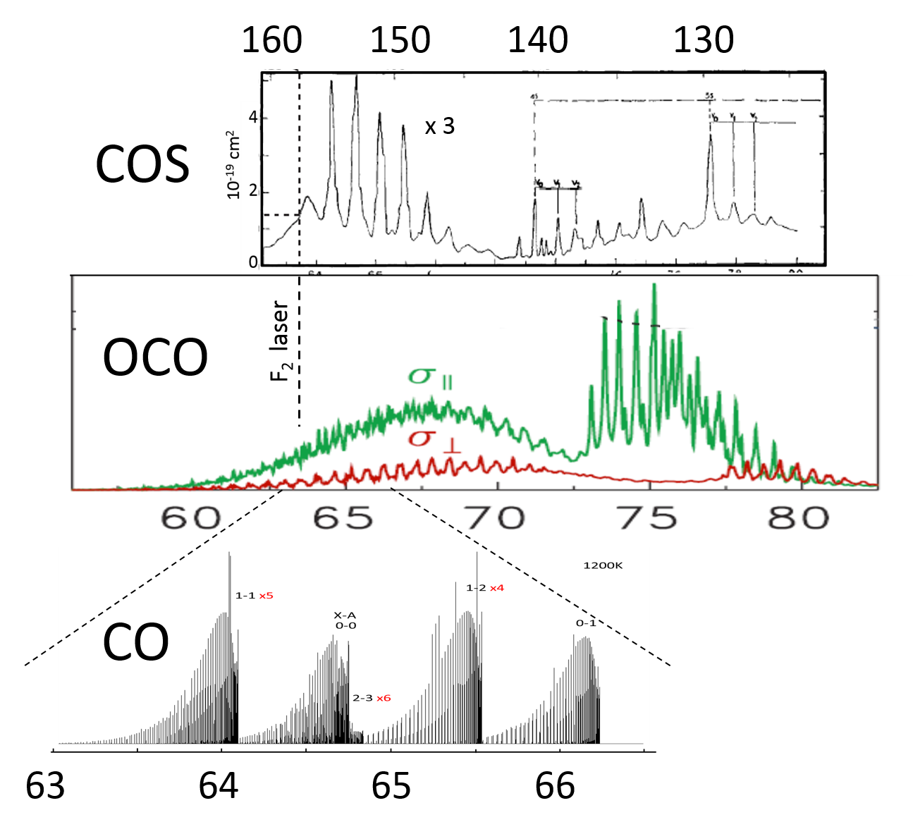
CO, CO₂ and COS in the VUV
x 10³ cm⁻¹

Slide 29
CO detection
CO₂ I.P. = 13.77 eV CO I.P. = 14.01 eV
155 nm
Xe
650
CO⁺(X)
248 nm
650
248 nm
155nm
248 nm
155 nm
CO(A)
I.P. CO₂
8.00 eV
CO(X)+O(¹D)
7.42 eV
155nm
CO(X)
CO(X) +O(³P) D₀
5.45 eV

Slide 30
polarization
Prof. Arthur Suits (Wayne State, USA)

Slide 31
S. H. Gardiner, L.Lipciuc, C. Vallance, T. Karsili and M. N. R. Ashfold,
Phys. Chem. Chem. Phys., 2014, DOI:10.1039/C4CP04654D

Slide 32
Take-home message
Highly sensitive and informative method
Steps towards full 100-200nm scans
O₂ – deviation from theory for weak channels
COS – PHOFEX-LIF S atoms, non-axial recoil
CO₂ – strong polarization, smoother
CH₃OH – clusters, CH₃ images 118 nm detection (see Ashfold paper on CH₃I!)
thanks!

